Slide 1

a
EC 1.14.18.1
EC 1.10.3.1
EC 1.10.3.4
b
Monophenolase
AbPPO3
P-Coumaroyl unit (H)
Monophenolase
MtPPO7, MtPPO-809,
MtPPO-010, CgPPO-473,
CgPPO-266, PpPPO-c2092
Guaiacyl unit (G)
Monophenolase + demethoxylation
MtPPO7, CgPPO-1473,
CgPPO-266
Syringyl unit (S)

Slide 2
a
Monophenolase
(Monooxygenase)
Diphenolase
(2e⁻ oxidation)
b
Coupled binuclear copper (CBC) proteins
Hemocyanins
Polyphenol oxidases
O₂ transportation
Tyrosinases
Catechol oxidases
O-Aminophenol oxidases
”O-methoxy phenolases”
Guaicyl
Syringyl

Slide 3
a
Monophenolase
(Monooxygenase)
Diphenolase
(2e⁻ oxidation)
b
Coupled binuclear copper (CBC) proteins
Hemocyanins
Polyphenol oxidases
O₂ transportation
Tyrosinases
Catechol oxidases
O-Aminophenol oxidases
”O-methoxy phenolases”
Mono- and diphenolase activity
Diphenolase activity
C-nitrosation activity
O-methoxy phenolase activity
Guaicyl
Syringyl

Slide 4
a
Coupled binuclear copper (CBC) proteins
Hemocyanins
Polyphenol oxidases
O₂ transportation
Tyrosinases
Catechol oxidases
O-Aminophenol oxidases
”O-methoxy phenolases”
Mono- and diphenolase activity
Diphenolase activity
C-nitrosation activity
O-methoxy phenolase activity
Guaicyl
Syringyl
b
Monophenolase
(Monooxygenase)
Diphenolase
(2e⁻ oxidation)

Slide 5
Monophenolase
(Monooxygenase)
Diphenolase
(2e⁻ oxidation)

Slide 6
Guaicyl
Syrringyl
Guaicyl
Syrringyl

Slide 7
a
b
*1
c
d
e
f
g
*2
h
i
*1
*2

Slide 8
a
b
*1
c
d
e
f
g
*2
h
i
*1
*2

Slide 9
a
b
c
d
e
f
g
h
i
j
k
l

Slide 10
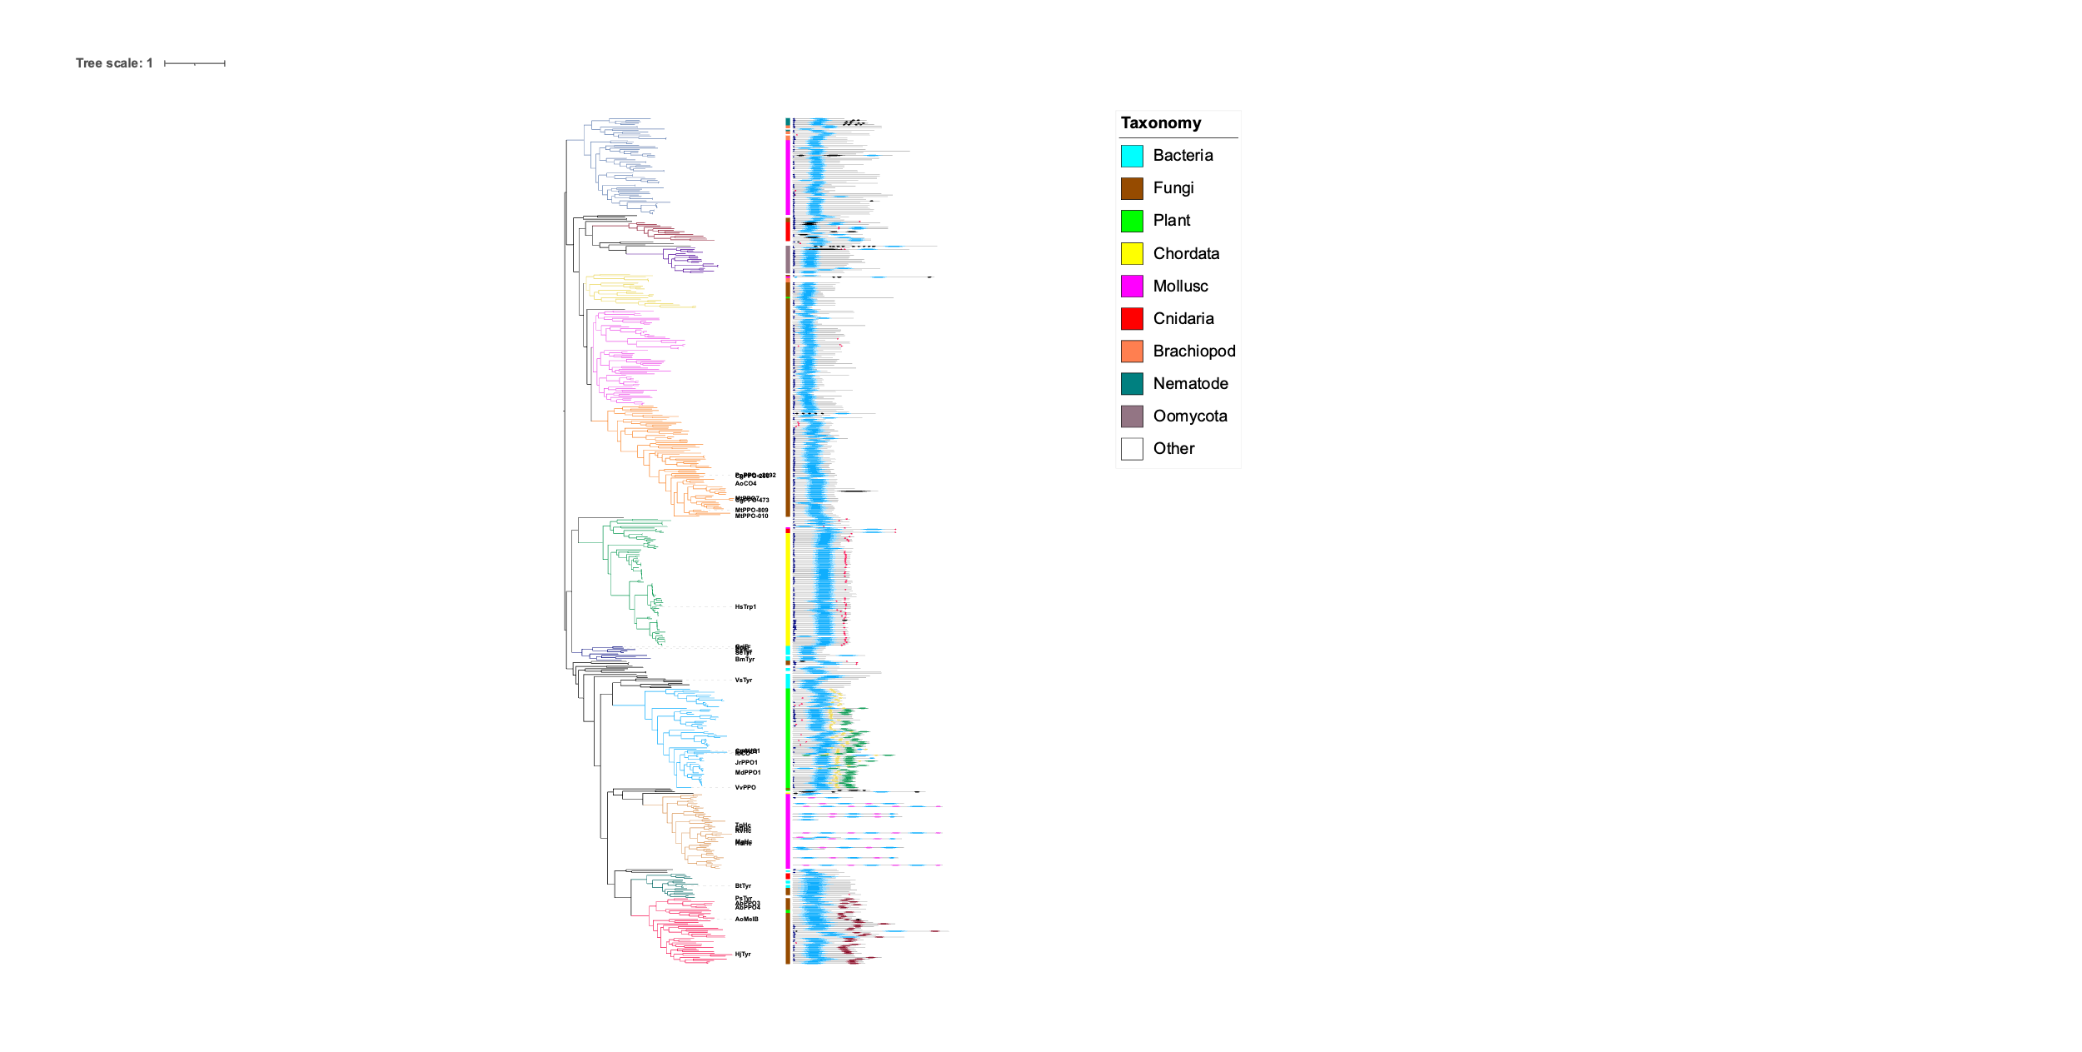
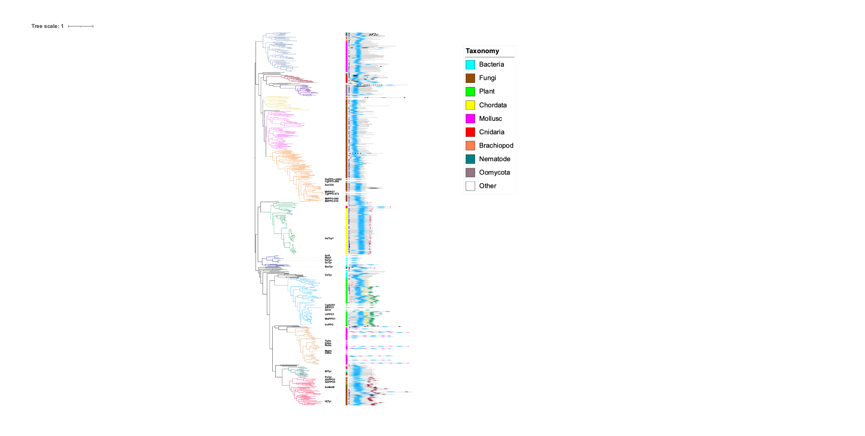
a
b
c
d
e
f
g
h
i
j
k
l

Slide 14

CuA binding motif
CuB binding motif
ppovv
+84
Gatekeeper, F259, 68%, Kampatsikas
Thioether
+62
Blocker residue, Kanteev
+32
+202
+130
First activity controller (HisB₁+1), Kampatsikas
+77
aoco4
+93
+68
The seventh His (HisB₃-1), Kampatsikas

Slide 15

Cu_{A} binding motif
Cu_{B} binding motif

Slide 16
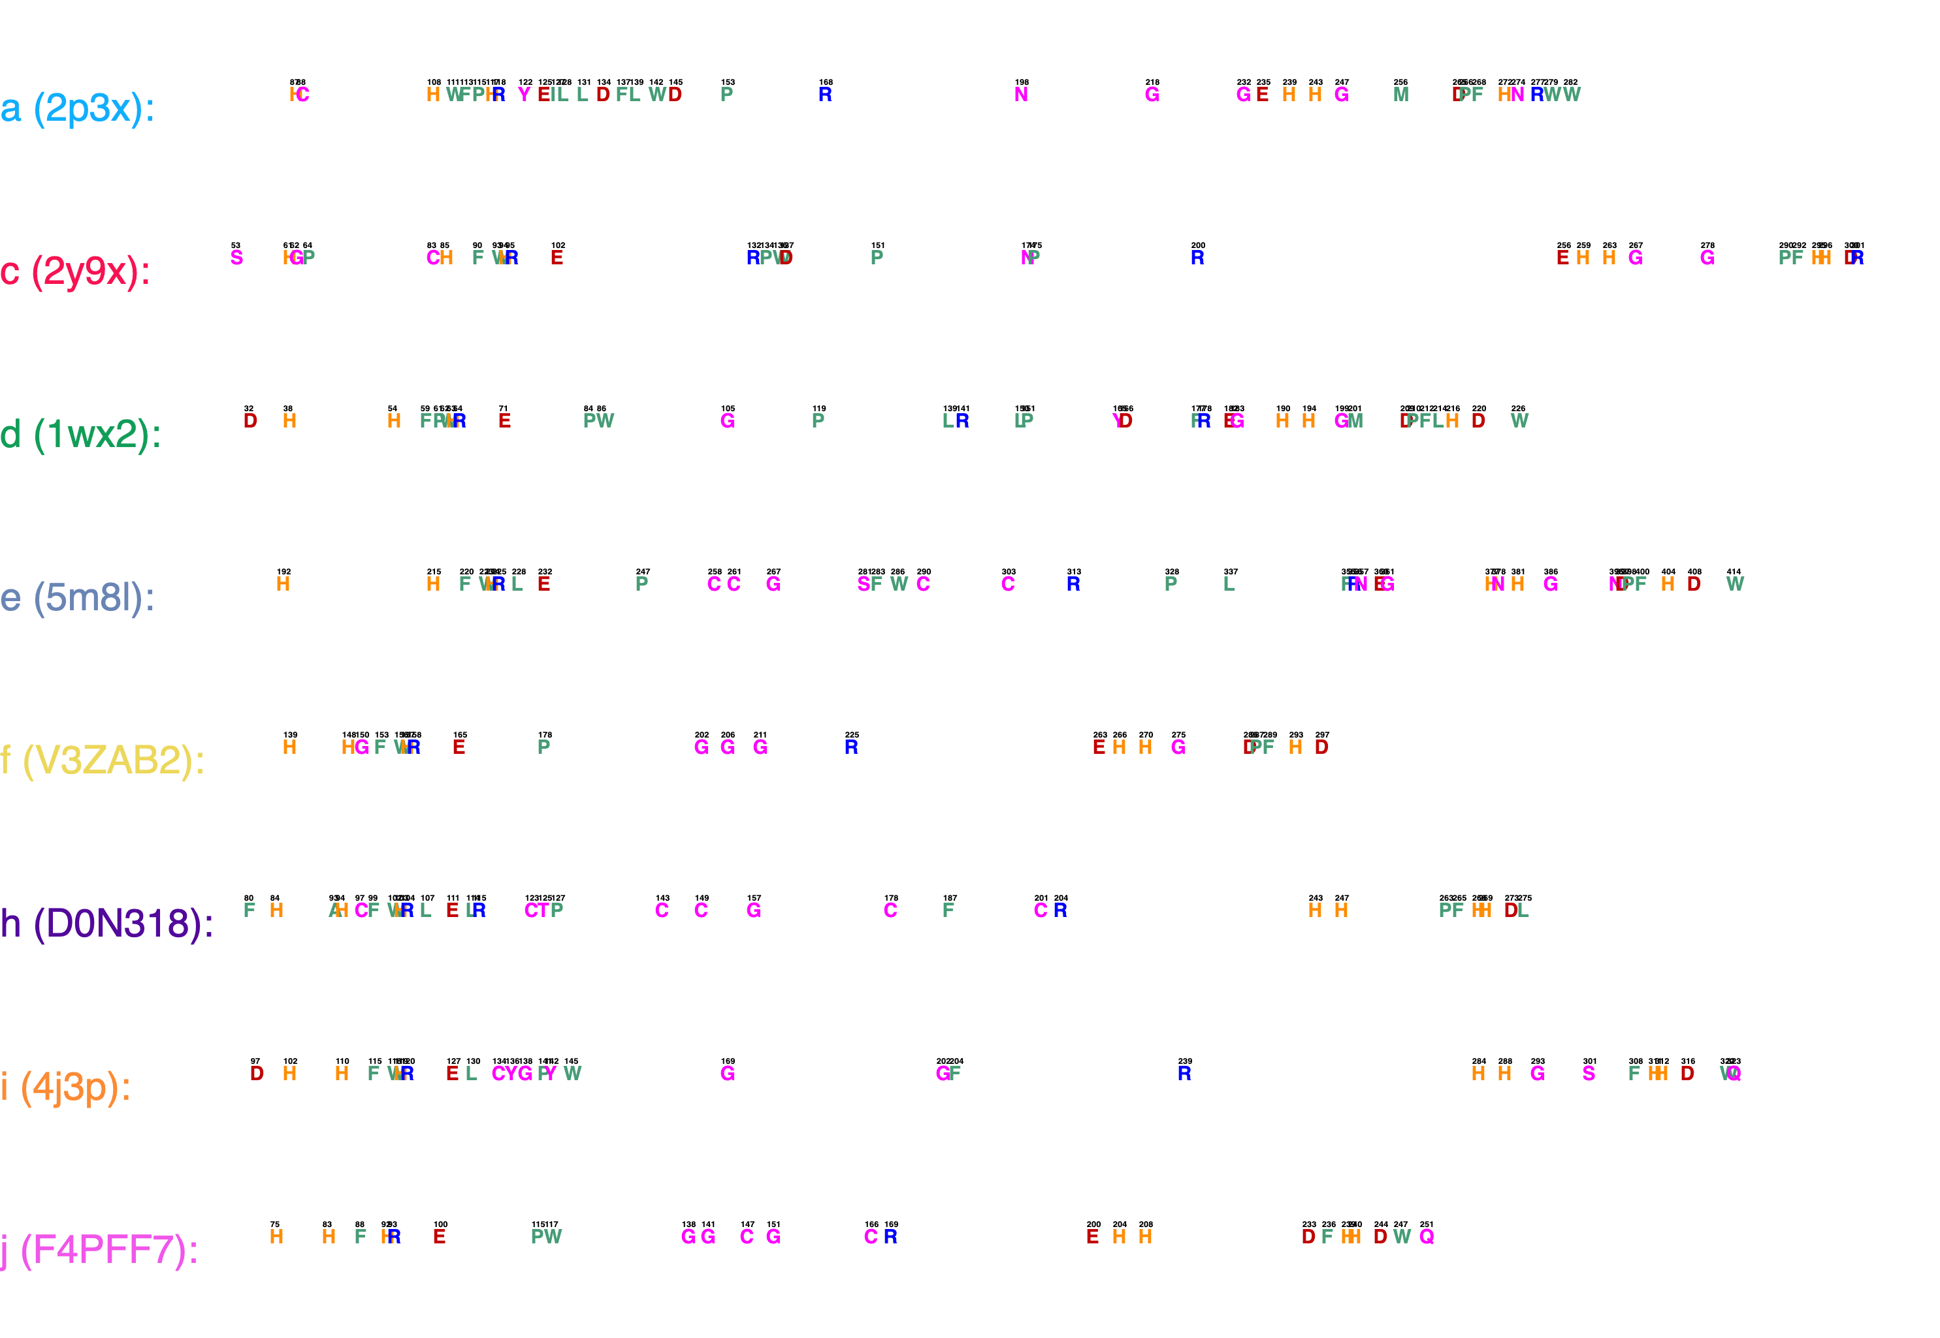
a
Cu_{A} binding motif
Cu_{B} binding motif
b

Slide 17
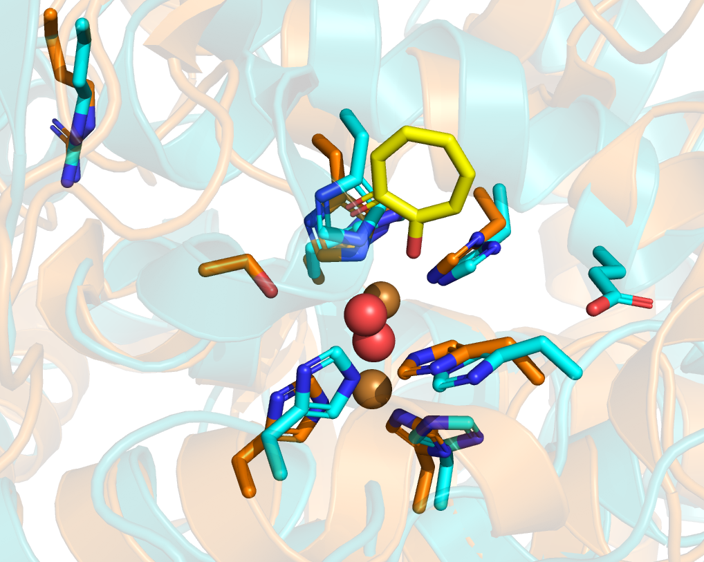
a
Cu_{A} binding motif
Waterkeeper residue
Cu_{B} binding motif
1st activity controller
Seventh histidine
b
Arg-239
Arg-200
2y9x (AbTyr, type c)
Tropolone
4J3P (AoCO4, type h)
Ser-302
Glu-256

Slide 18
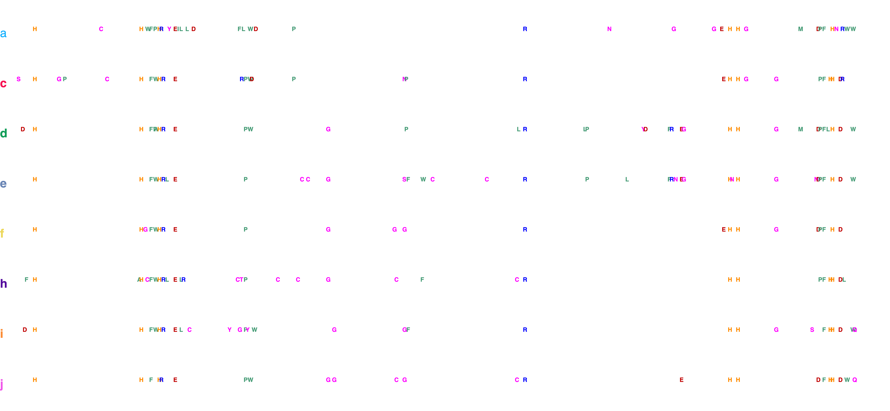
Cu_{A} binding motif
Cu_{B} binding motif

Slide 23
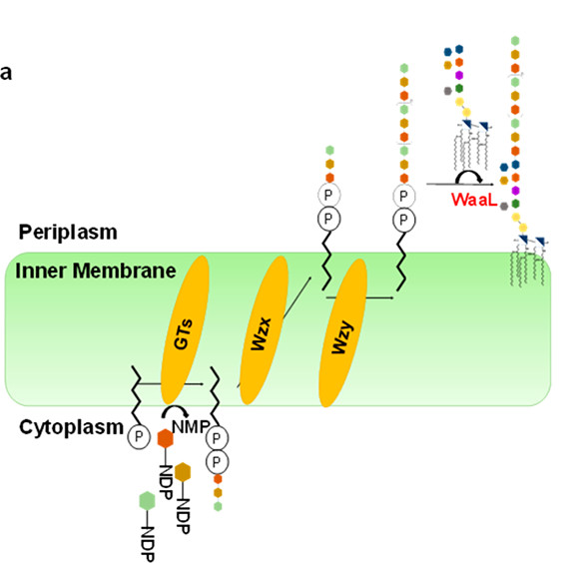

Slide 24
